Slide 1
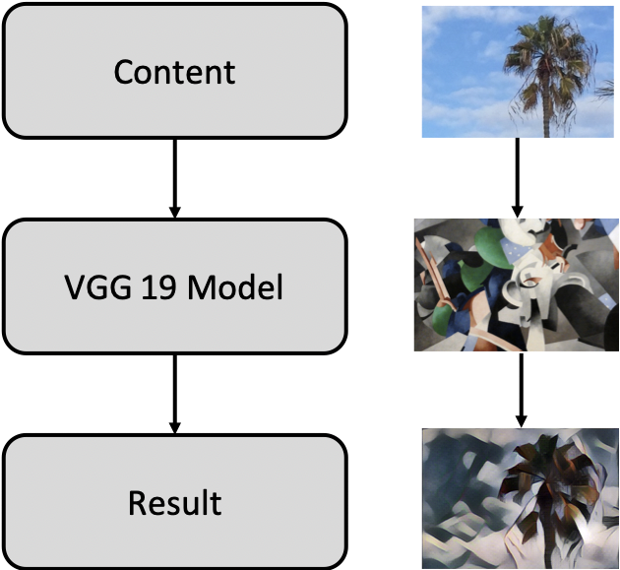
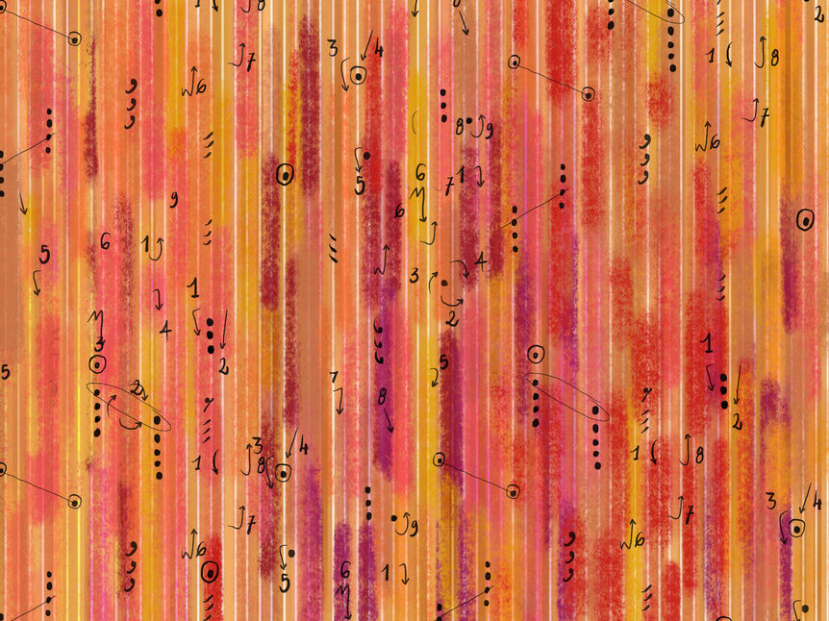
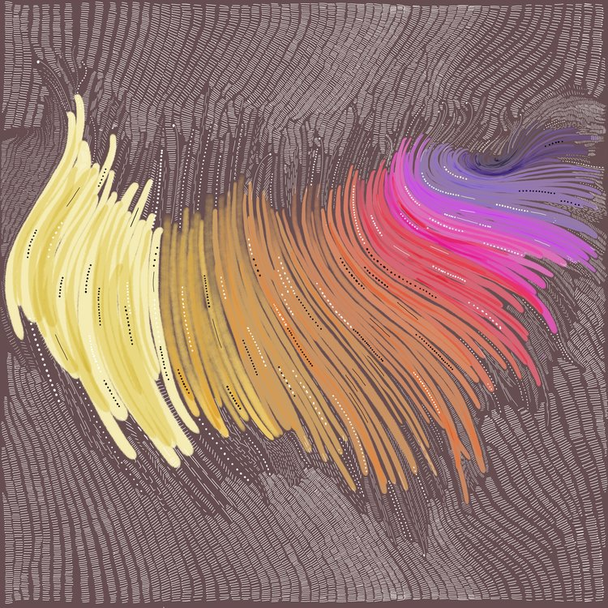
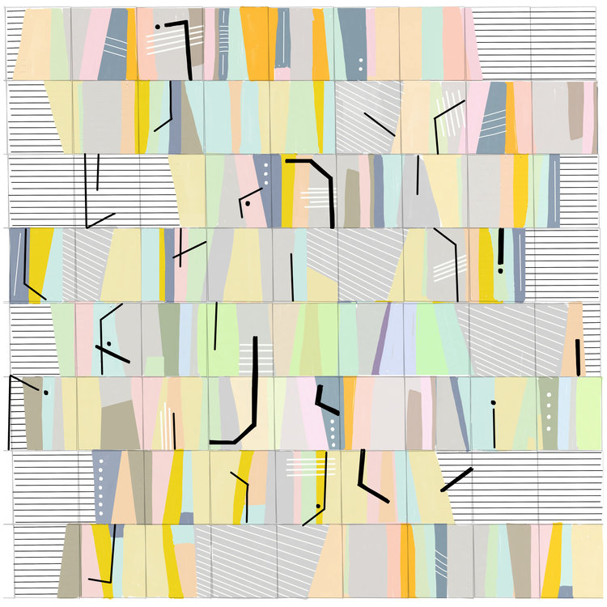
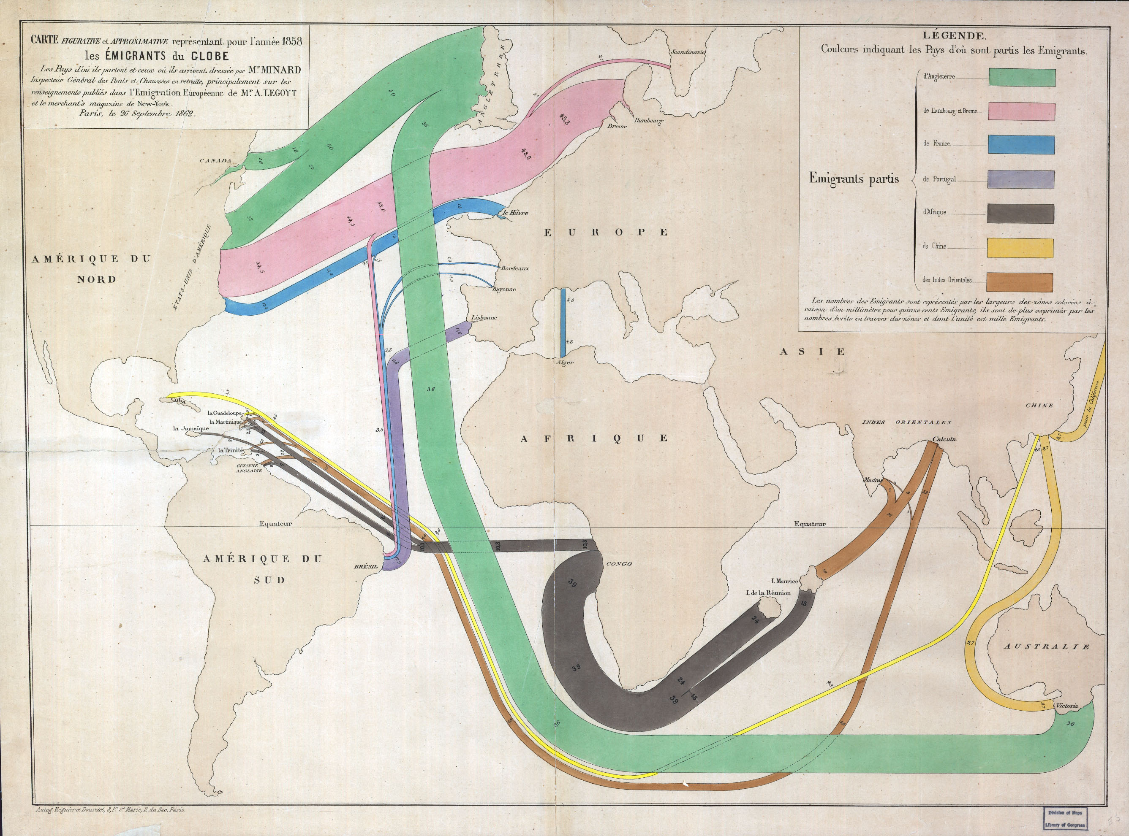
Interactive Canvas Style Transfer
Mahika Dubey
mahika@ucsc.edu
Jasmine Otto
jtotto@ucsc.edu
Creative Coding Lab
UC Santa Cruz
Introduction and Motivation
We have created web applications for the application of multiple style-transfer brushes onto an image, allowing users to interact with deep convolutional neural networks to co-create customized art. The applications provide new perspectives on a well-known algorithmic process, and enhances intuition for its expressive range, or lacks therein.
What is Style Transfer?
Style transfer is a now commonly used method of applying style features of an image to the content of a new image to generate a similar result. All models used in this application were produced from running a single content image input through a 19 layer feature extractor network (VGG-19) that has been trained on over a million images from ImageNet.
Magic Markers
The Magic Marker application uses natural brush interactions so that users can ’paint’ on different styles through intuitive selection and dragging.
Compositing Stamps
The Compositing Stamps application uses real time transfer of selected sections of an image to layer on patches of style to create interesting works of art resembling tiled mosaics or collages.
Art Creation Process
We sought to understand the role of artistic vision in art creation. In the physical world, does intended layout take precedence over colors? Or do artists bring to their canvas a preconceived personal bias towards a certain style, and let the layout appear as a result of their own creativity? Thinking of style transfer inherently separates the creative process for creating an art piece by forcing the user to pick out an image to modify (layout) in its entirety, and identifying an existing style to mimic (colors). The traditional roles of artist and curator are intertwined.
Painter Brushes
Initial framework used only pre-trained brushes available from ml5.js, a Javascript library for web-based machine learning projects.
DataViz Art Brushes
We created custom brushes using famous data visualization art pieces by Giorgia Lupi and Charles Minard.

